Slide 1

Musings from CSA Training Bootcamp
Todd Schick, RBA Software
Notes:
Cloud Software Architect (CSA) Training
A training program for new CSA’s.
This particular bootcamp was experimental in that MS also invited architect representatives of some partners (which included RBA).
There were about 200 new CSA’s and 100 partners.
Consisted of sessions with core Microsoft Azure technologists, Case Study Workshops, Hackathons.
Each day consisted of 11+ hours of activities with about 1.5 hours of total breaktime – meaning, there was a ton of very good information presented.
Here are some of the more-important take-aways which are, in my opinion, most-pertinent to RBA and it’s customers.

Slide 2
Big Data Architecture
Big Data defined by
Volume
TB, PB, EB
Files, File Sets, Events, Tuples
Variety
Varying types
Varying schemas within same type
Unstructured
Binary
Velocity
Social, news, trending data
Real-time events, telemetry
Lambda architecture brings together streaming and batch paths to deliver holistic analytics
Notes:
Note: Lambda Architecture has hot and cold paths. Also, note the need to have batch input. The objective is to get all data into the system in whichever way makes sense, so that it can be analyzed as needed now or in the future.

Slide 3

Neudesic partnered with one of the nation's largest utility companies that recently deployed Smart Utility Meters for power customers, nearly a million meters sending usage data every 15 minutes.
The result: an Azure hybrid big data processing solution that enabled the customer to perform gap analytics: a process for identifying gaps that exist in the power usage readings, over 7x faster than their previous solution! Billions of Smart Meter reads get processed to identify the nature and duration of the gaps to mitigate revenue losses.
Notes:
Challenge
Collect electric power usage for nearly a million customers at a 15 minute interval.
Being able to analyze the meter reads to identify issues with Smart Meters and prioritize them for troubleshooting.
Minimize/ avoid deploying technicians to detect meter issues.
Nearly a million Smart Utility Meters sending data every 15 minutes
KWH Usage, alerts and on-demand reads
Data needs outgrew company’s internal datacenter and data warehouse
Solution
Chose Azure HDInsight, SQL Server 2014, Database, SSIS and SSAS.
Dashboards and for reports for
Top 25 meters with the longest continuous outages
Peak load hours by Zip code
Total power usage by hour
Future: Goal is to integrate additional Azure Services including Azure ML and SQL DW
How They Did It
Extract Data from current Oracle Database and load into SQL Server
Use system generated Keys for Customer, Meter
Move a copy of the data without any PII information to Azure Blob Storage
Use Hadoop to execute scripts and SQL Server Job Agent to orchestrate
Hive and Pig scripts executed using PowerShell and orchestrated using SQL Server Job agent
Output of the script processing stored in external HIVE tables
Data downloaded Using AZCopy to a local BI Server
Downloaded data loaded to SQL Tables using SSIS
Analytics and Reporting
SQL Server Analysis Services Cube processed
Provide users with customizable interface
Use Office BI tools for Self Service BI and SSRS for canned reports.

Slide 4


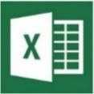


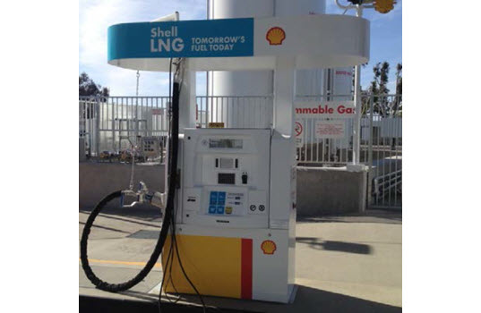
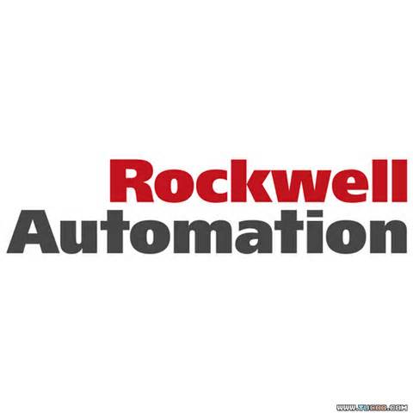
Rockwell Automation has partnered with one of the six oil and gas super majors to build unmanned internet-connected gas dispensers. Each dispenser emits real-time management metrics allowing them to detect anomalies and predict when proactive maintenance needs to occur.
Azure HDInsight
Data
Factory
Power BI for O365
Mobile Device
Hive, Pig,
Real-time notification
Mobile Notification Hub
Azure Blobs
Azure SQL DB
Store sensor data every 5 minutes
Temperature, pressure, vibration, etc.
Tens of thousands of data points / second
Notes:
Challenge
Manage sites used for dispensing liquefied natural gas (clean fuel for commercial customers who do heavy-duty road transportation)
Built LNG refueling stations across US interstate highway
Stations are unmanned so they built 24x7 remote management and monitoring to track diagnostics of each station for maintenance or tuning
Built internet-connected sensors embedded in 350 dispenser sites worldwide generating tens of thousands data points per second
Temperature, pressure, vibration, etc.
Data needs outgrew company’s internal datacenter and data warehouse
Solution
Chose Azure HDInsight, Data Factory, SQL Database
Dashboards used to detect anomalies for proactive maintenance
Changes in performance of the components
Energy consumption of components
Component downtime and reliability
Future: Goal is to expand program to hundreds of thousands of dispensers
How They Did It
Collect data from internet-collected sensors
Tens of thousands data points per second
Interpolate time-series prior to analysis
Stored raw sensor data in Blobs every 5 minutes
Use Hadoop to execute scripts and Data Factory to orchestrate
Hive and Pig scripts orchestrated by Data Factory
Data resulting from scripts loaded in SQL Database
Queries detect site anomalies to indicate maintenance/tuning
Produced dashboards with role-based reporting
Azure Machine Learning , SSRS, Power BI for O365
Provide users with customizable interface
View current and historical data (day-to-day operations, asset performance over time, etc.)
Leveraged Azure Mobile Notification Hub for real-time notifications, alarms, or important events

Slide 5
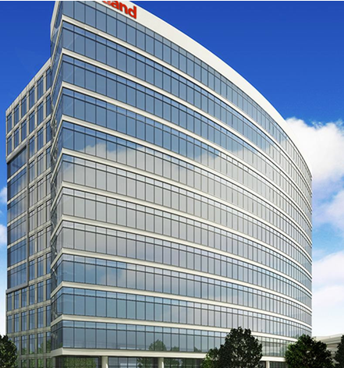
Notes:
This is Heartland’s Data Ingestion System. The HOT path implementation is complete. We still need to implement the cold path.
Along with batch input. Explain the need with batch.

Slide 6
Microsoft Data solution Overview (CIS)
Information Management
Big Data Stores
Machine Learning and Analytics
Intelligence Capabilities
Data Sources
People
Data Factory
Data Lake Store
Machine Learning
Cognitive Services
Data Catalog
SQL Data
Warehouse
Data Lake Analytics
Bot Framework
Web
Apps
HDInsight
(Hadoop and Spark)
Event Hubs
Cortana
Mobile
Apps
Stream Analytics
Bots
Dashboards & Visualizations
Sensors and devices
Power BI
Automated Systems
Data
Intelligence
Action
Notes:
Data Factory: Is the ETL tool offered by Microsoft. Can potentially replace SSIS.
- There IS NO DF Source Connector for Mongo. There is one for DocDB
Event Hub, and IOT Hub, for streaming event data into the system as part of a hot path.
Data Lake Analytics instead of HDInsight, for MS-based big data implementations.
Stream analytics enables ongoing query to be run against streaming input data (like from Event/IOT Hubs), then output to streaming reports (something that PowerBI can handle).
Talk about intelligence capability demos.
Then transition into Machine Learning.
Cortana Intelligence delivers an end-to-end platform with an integrated and comprehensive set of tools and services to help you build intelligent applications that let you easily take advantage of Advanced Analytics and intelligence capabilities.
First, Cortana Intelligence provides services to bring data in, so that you can analyze it. It provides information management capabilities like Azure Data Factory so that you can pull data from any source (relational DB like SQL or non-relational ones like your Hadoop cluster) in an automated and scheduled way, while performing the necessary data transforms (like setting certain data columns as dates vs. currency etc). Think ETL (Extract, Transform, Load) in the cloud. Event Hubs does the same for IoT type ingestion of data that streams in from lots of end points.
The data brought in then can be persisted in flexible big data storage services like Data Lake Store and Azure SQL Data Warehouse.
You can then use a wide range of analytics services from Machine Learning to Azure Data Lake Analytics to Azure HDInsight to Azure Stream Analytics to analyze the data stored in the big data storage. This means you can create analytics services and models specific to your business need (say real time demand forecasting).
The resultant analytics services and models created by taking these steps can then be surfaced as interactive dashboards and visualizations via Power BI.
These same analytics services and models created can also be integrated into various different UI (web apps or mobile apps or rich client apps), or with Cortana, so end users can naturally interact with them via speech etc., and so that end users can get proactively be notified by Cortana if the analytics model finds a new anomaly (unusual growth in certain product purchases- in the case of real time demand forecasting example given above) or whatever deserves the attention of the business users. Similar integration can occur with Cognitive Services or Bot Framework based applications.
At a high level though, Cortana Intelligence capabilities are in three main areas: data, analytics and intelligence.
<Transition>: We’re going to dive into each one, starting with data.

Slide 7


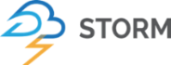
Azure Data Lake Analytics Service
Microsoft Azure Data Lake
Significantly reduce learning burden for Big Data adoption
Resonates with enterprise customers starting big data journey
Based heavily on our Cosmos Experience
Technology that already supports massive use cases
Ongoing transfer of lessons learned from Cosmos ecosystem
Productive day one
Industry leading development tools (for novices & experts)
U-SQL: simple and familiar, easily extensible
Platform that enables future workloads
Hive coming soon
Analytics Service
HDInsight
U-SQL
YARN
HDFS
Store
1
1
1
1
1
1
1
1
1
1
1
1
Notes:
HDInsight, which is Apache Hadoop, has been ported to Azure and runs as a first-class service.
Reason was to enable existing java-based Hadoop projects to easily be moved onto Azure.
Azure Data Lake Analytics leverages Hadoop and MS’ own big data technologies.
It is built on .NET so Map Reduce functions can be built in C#, as opposed to java, or through standard io shims (called streaming)
Cluster node management is handled by ADLA under-the-covers so developers don’t necessarily need to know details.
Currently in preview. Omid Afnan, Group Program Manager of Big Data @ MS is getting us hooked up with Heartland.

Slide 8
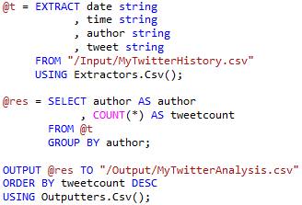
U-SQL
Simple and familiar, easily extensible
Unifies declarative nature of SQL with expressive power of C#
Distributed query support for rapid experimentation over all different shape and sources of data
Familiar syntax to millions of .NET developers
EXTRACT statement:
Schema on read that is powerful and simple
TABLES:
Structured big data with partitioning control

Slide 9
Going Beyond Business Intelligence
How can we make it happen?
Prescriptive Analytics
What will happen?
Predictive Analytics
OPTIMIZATION
Why did it happen?
FORESIGHT
VALUE
What happened?
Diagnostic Analytics
INSIGHT
Descriptive Analytics
HINDSIGHT
INFORMATION
Traditional BI
Advanced Analytics
Source: Gartner
DIFFICULTY
Notes:
Machine learning is an Azure service whereby Azure learns from historical data, then builds a knowledge model for predicting future events.
First let’s start by level setting what we mean by Advanced Analytics. We often get asked whether Advanced Analytics is just “BI” with fancier branding. This chart helps to illustrate why that is not the case.
Put simply, BI is a tool that is designed to show you what has happened so you can make your own decisions about what to do next. The next level – Advanced Analytics – allows you to take that data to the next level by having the computer predict what will happen next. This is more accurate than a human can ever hope to be, as the computer can reason over far more variables than a human can on a BI dashboard. But predictive is only the first step, the next step is once you are accurately predicting the future you can program the computer further to anticipate those occurrences and react accordingly.

Slide 10
Use Cases for Advanced Analytics
EXAMPLE SOLUTIONS
Sales and marketing
Finance and risk
Customer and channel
Operations and workforce
Sales forecasting
Fraud detection
User segmentation
Agent allocation
Demand forecasting
Credit risk management
Personalized offers
Warehouse efficiency
Sales lead scoring
Product recommendation
Smart buildings
Marketing mix optimization
Predictive maintenance
Supply chain optimization
Notes:
Fraud detection is just one scenario where we’re seeing very broad use of Advanced Analytics. The above is just a snapshot, but it gives you an idea of the other areas where Advanced Analytics is helping solve tough business problems.
For example sales and marketing is the #1 use of Advanced Analytics today. That’s because most any business of any type can benefit from knowing what customers are going to stay or leave, how to keep the churn risk segment happy and how to make the most of their most valuable customers. We have some more specific examples of that coming up.

Slide 11




Will You Board the Titanic?

Slide 12
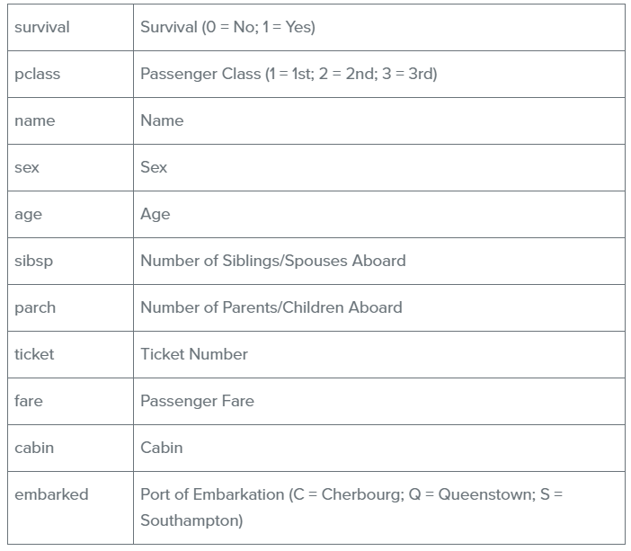
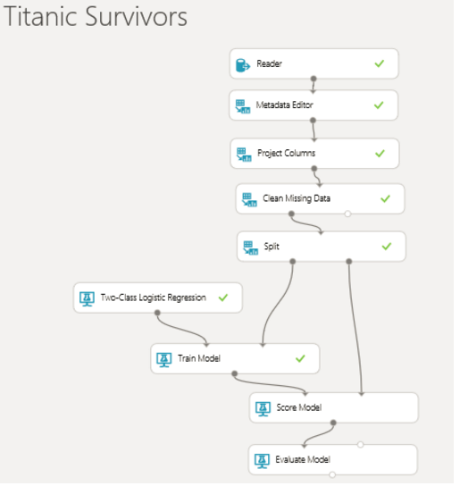
Using Machine Learning to Make Predictions
Notes:
About 900 passengers. Describe the fields. Split out training data.

Slide 13
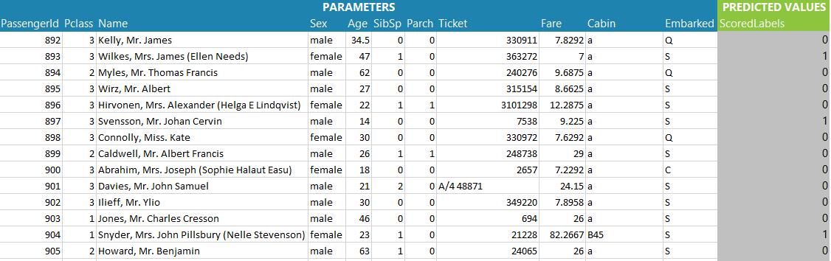
Machine Learning with MS Excel

Slide 14













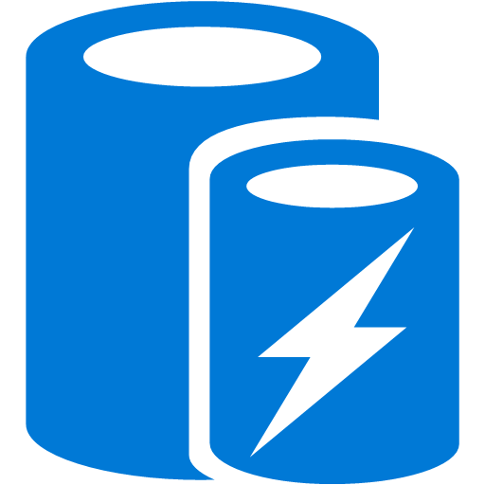
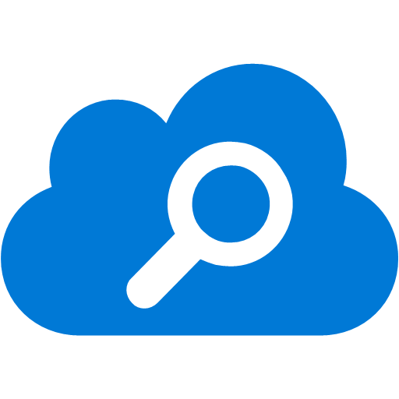


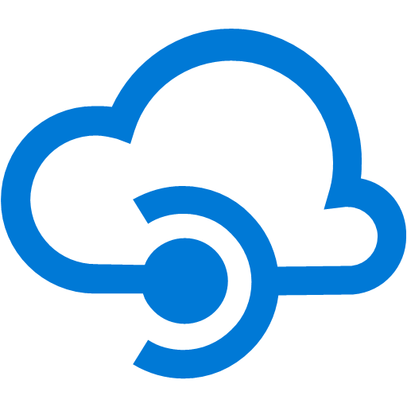

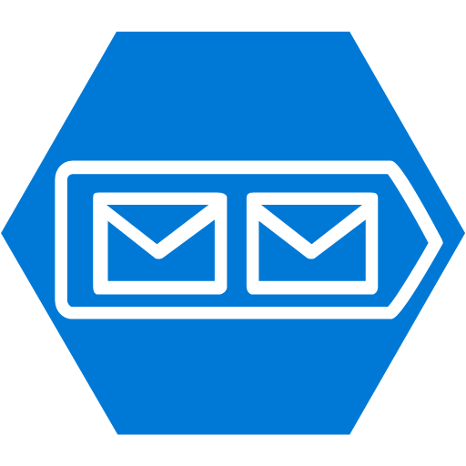
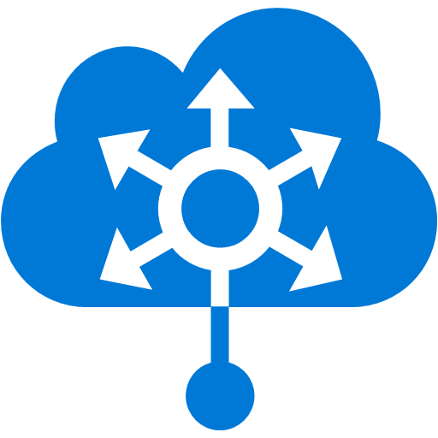
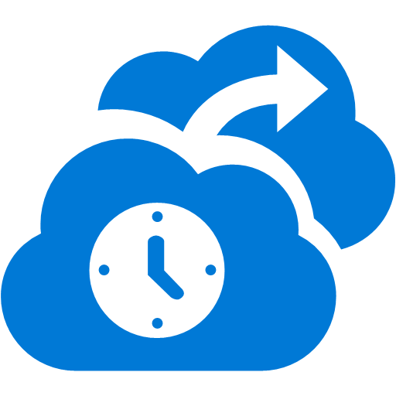




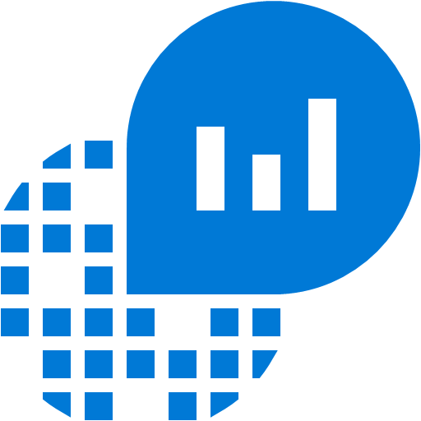

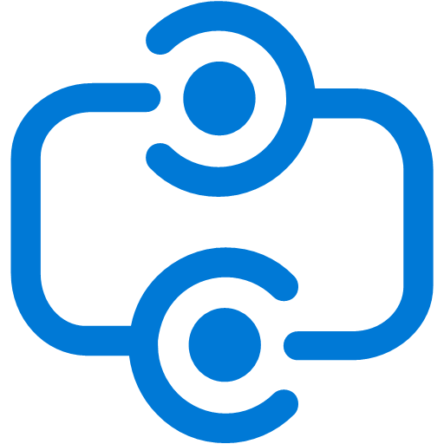
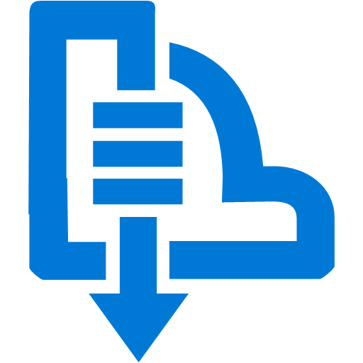

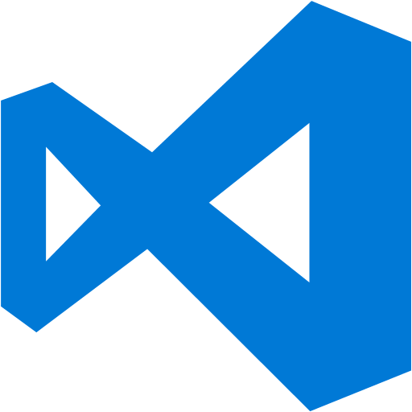


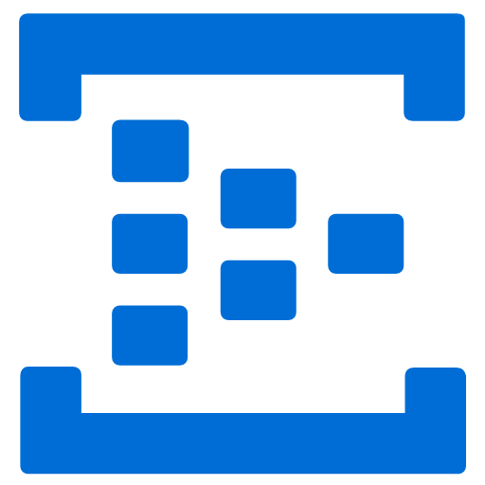
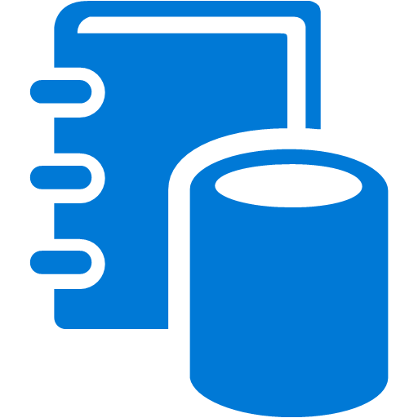



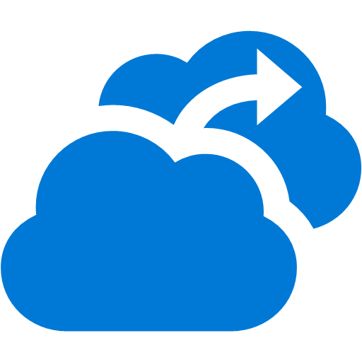

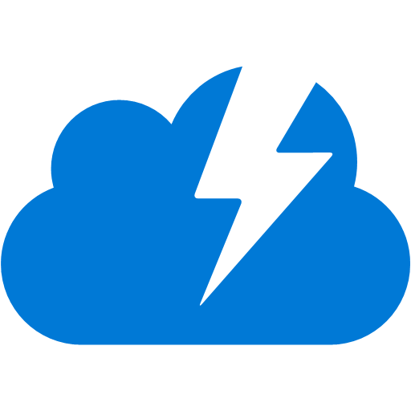













Platform Services
Security & Management
Services Compute
Web and Mobile
Data
Hybrid
Operations
Cloud
Services
Service
Fabric
Web Apps
API Apps
Portal
SQL
Database
Data
Warehouse
DocumentDB
Azure AD
Health Monitoring
Azure Active
Directory
Batch
RemoteApp
AD Privileged
Identity
Management
Mobile
Apps
Logic Apps
Redis
Cache
Azure
Search
Storage
Tables
Azure AD
B2C
Integration
Domain Services
Multi-Factor
Authentication
API
Management
Notification
Hubs
Storage
Queues
BizTalk
Services
Analytics & IoT
Backup
Automation
Hybrid
Connections
Service Bus
Developer Services
HDInsight
Machine
Learning
Stream
Analytics
Data
Lake
Operational
Analytics
Scheduler
Key Vault
Visual Studio
Azure
SDK
Data
Factory
Event
Hubs
Data
Catalog
Import/Export
Media & CDN
Store/
Marketplace
Media Services
Content Delivery
Network (CDN)
VS Online
App
Insights
Mobile
Engagement
Azure Site
Recovery
IoT Hub
VM Image Gallery
& VM Depot
StorSimple
Infrastructure Services
OS/Server Compute
Storage
Networking
Virtual Machines
Container
Service
BLOB Storage
Azure
Files
Premium
Storage
Virtual Network
Load Balancer
DNS
Express
Route
Traffic Manager
VPN Gateway
App
Gateway
Datacenter Infrastructure (24 Regions, 22 Online)
Notes:
Talk about IaaS, PaaS and Saas. We have been doing a lot with web apps, whereby a web app and any associated web jobs, run on a VM. Service fabric is another technology which supports micro-services (explain them). Service fabric manages compute nodes and microservices that run on them.

Slide 15
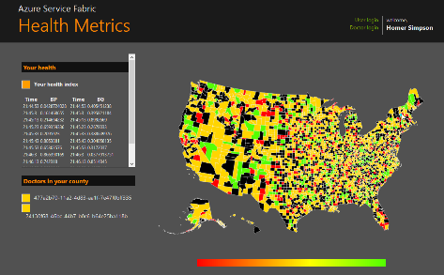
State in Monolithic approach
State in Microservices approach
Single monolithic database
Tiers of specific technologies
Graph of interconnected microservices
State typically scoped to the microservice
Variety of technologies used
stateless presentation services
stateless services
stateful services
stateless services with
separate stores

Slide 16
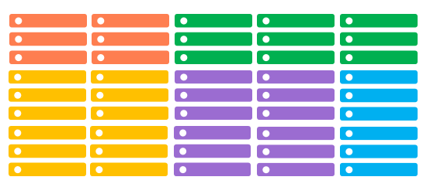
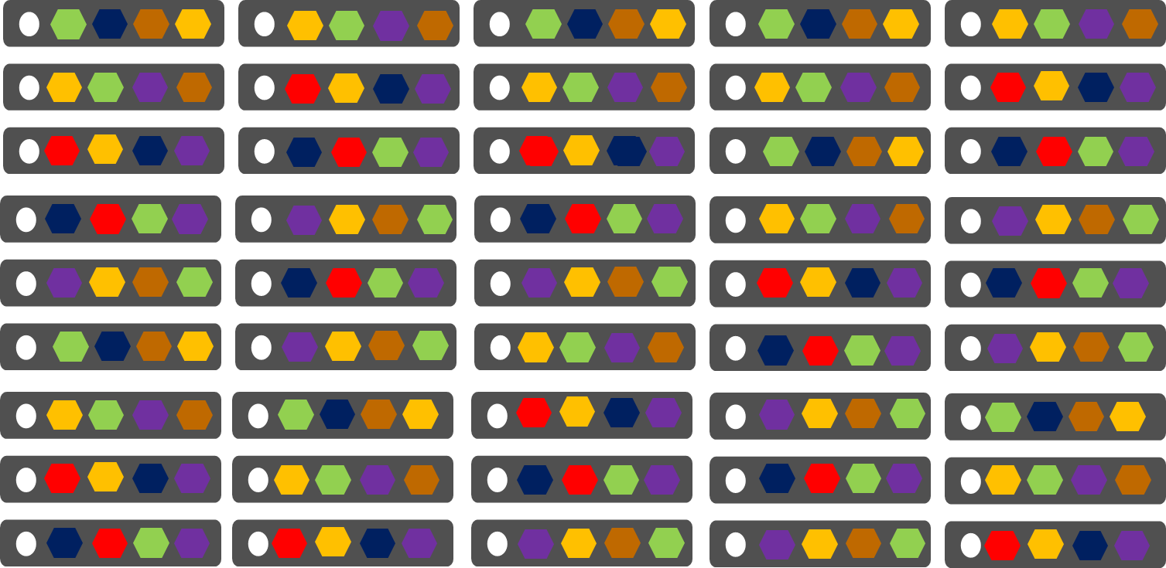
Comparing Azure Cloud Services vs. Azure Service Fabric
Azure Cloud Services
(Web and Worker Roles)
Azure Service Fabric
(Stateless, stateful or Actor services)
1 service instance per VM with uneven workloads
Lower compute density
Slow in deployment & upgrades
Slower in scaling and disaster recovery
Many microservices per VM
High microservices density
Fast deployment & upgrades
Fast scaling microservices across the cluster

Slide 17

Service Fabric cluster with microservices
App1
App2
Notes:
There are two important concepts to understand with Service Fabric
First you create a pool of machines called a Service Fabric cluster. This can start as small as 3 machines and grow to thousands of machines. It is fully elastic, and with no single point of failure.
This cluster of physical or virtual machines can be heterogeneous, some small, some large as well. In Azure the clusters can be deployed across availability sets and across regions for redundancy. These are VMs that you own, joined by a VNET and stitched together to form a scalable cluster.
Second you build applications that are composed of discrete microservices by writing code. Then you simply tell Service Fabric through a declarative model to deploy these service across the cluster Service Fabric determines the best place to insatiate and run them, based on the available machine resources. You can create multiple copies of the same application instance and you can reuse microservice across difference applications.
This is application and service orchestration achieving unparalleled levels of density and control at the APPLICATION level. The services are placed into containers, processes today and Windows Containers when they are available for resource and security isolation. Note; this is not simply about moving containers around, this is understand how to manage the microservices within those containers which is actually the code you as a developer write.

Slide 18
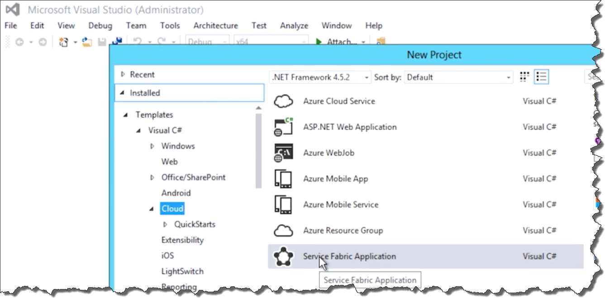
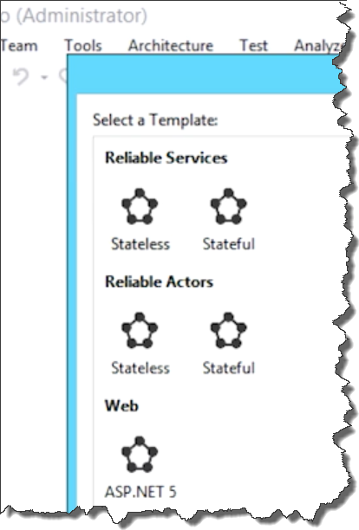
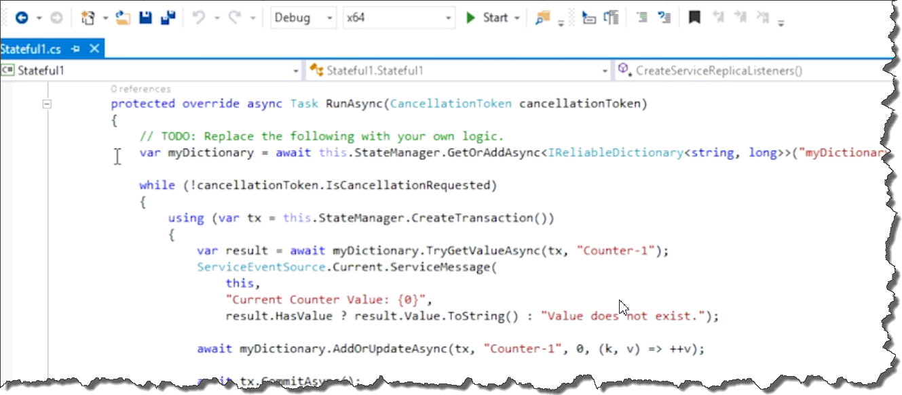
Notes:
Install the Service Fabric SDK
In code: Not that the event handers resemble those of cloud services.
ReliableDictionary and ReliableQueue are a mechanism to communicate between services, are failsafe, and are propogated between the nodes.

Slide 19
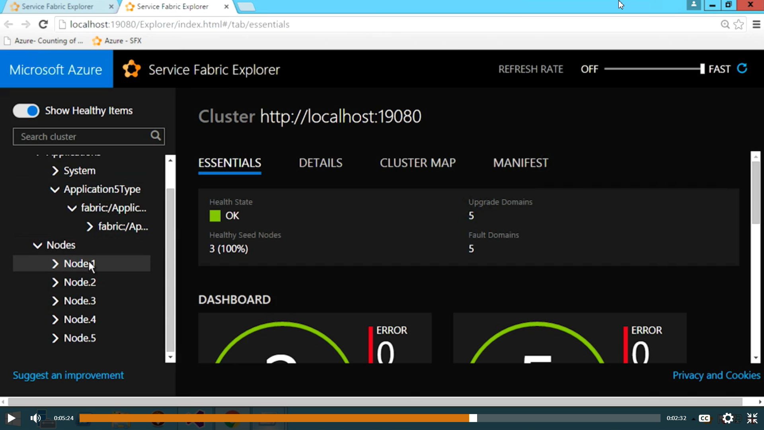
Notes:
When a microservice application executes, the Service Fabric deploys the microservice to a cluster of (default 5) nodes (vms).

Slide 20
Hyper-Scale Cloud
Rick Bakken
Senior Director, Datacenter Evangelism
Cloud Infrastructure & Operations
Notes:
Why is this important? Microsoft is making huge investments in their cloud infrastructure, including data centers. It’s important for customers considering investing in the cloud, including those torn between AWS and Azure.
Working on 5th (?) generation data centers – zero cooling costs. Software defined networking (SDN)

Slide 21












How BIG is Hyper-scale?
50+ billion
minutes of connections handled each month
70+ trillion
objects stored
1.2+ billion
users
2.4+ billion
emails per day
500+ million
Users in Azure Active Directory
50+ million
active users
85%
Fortune 500 users
Enterprise & Commercial
250+ million
active users
400+ million
active users
48+ million
users in 56 countries
7+ billion
worldwide queries each month
Consumer
1+ billion customers 20+ million businesses 90+ markets worldwide
Notes:
Usage of Azure is huge (compare to AWS and Google) and growing incredibly fast (numbers).

Slide 22
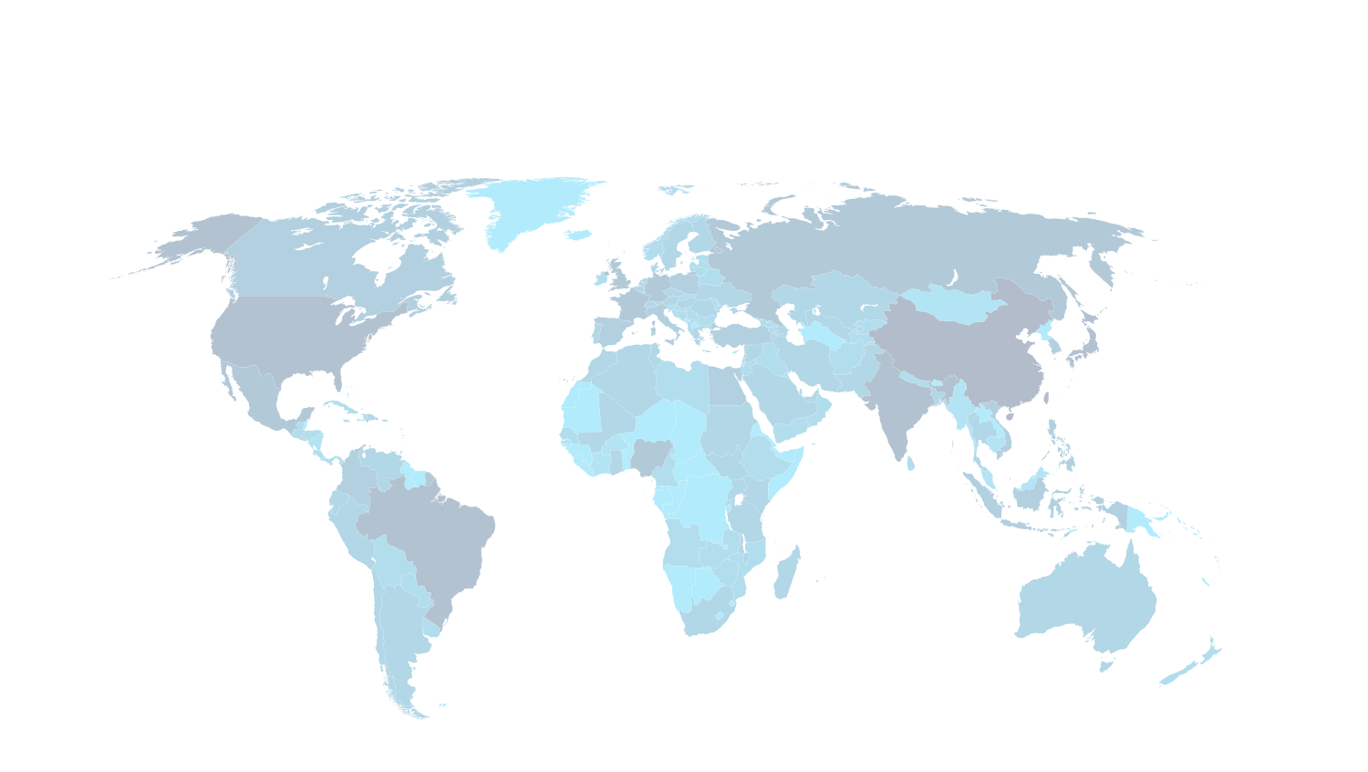
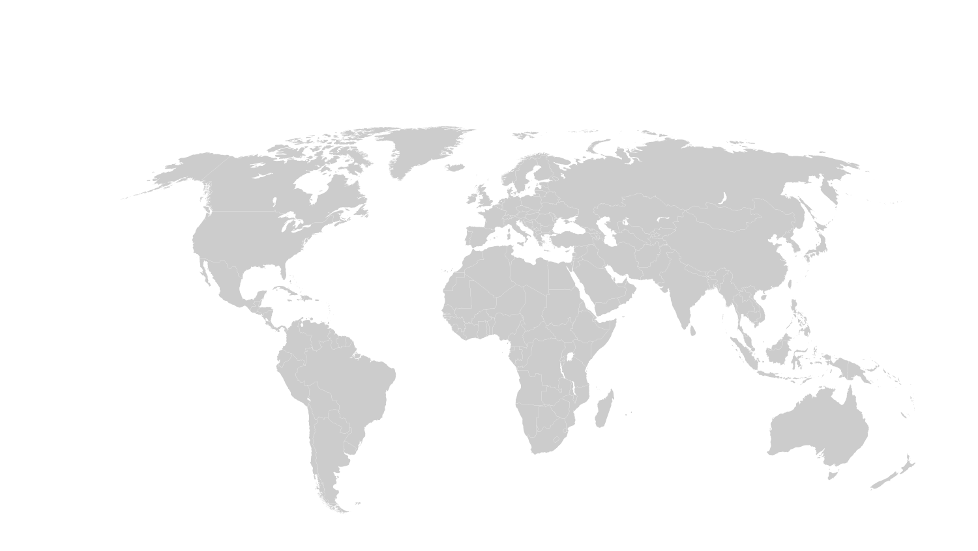
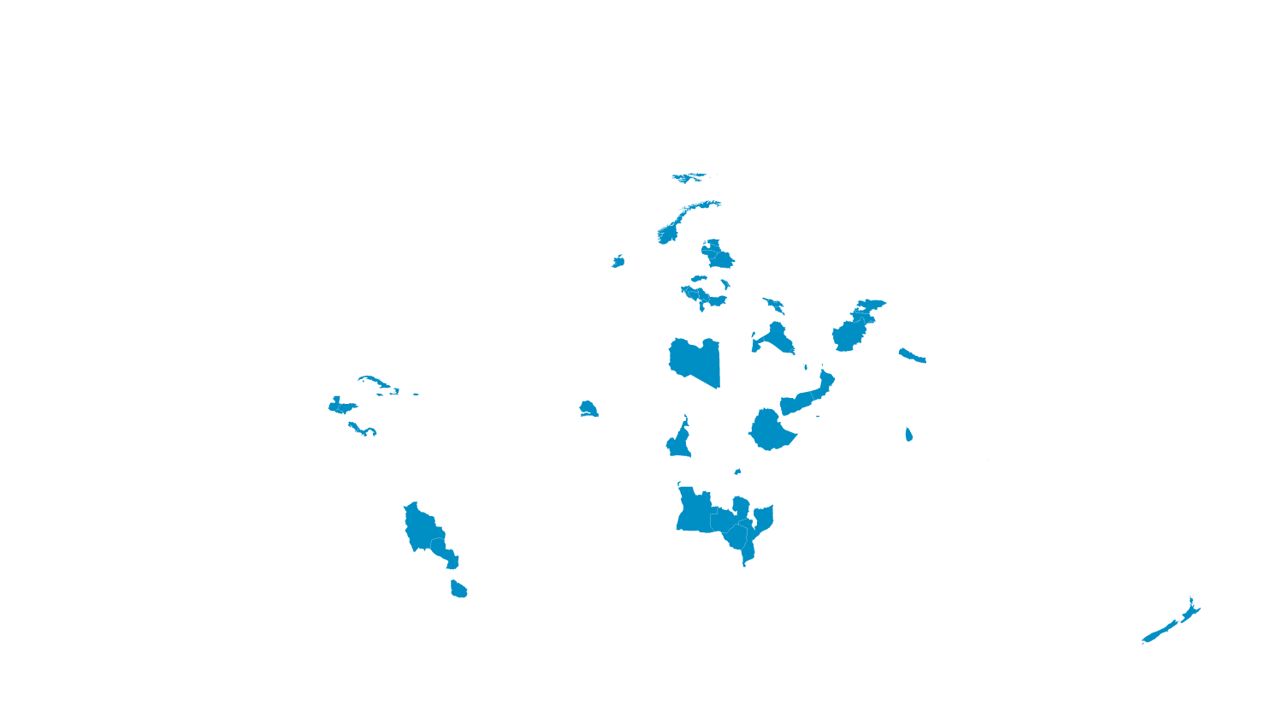
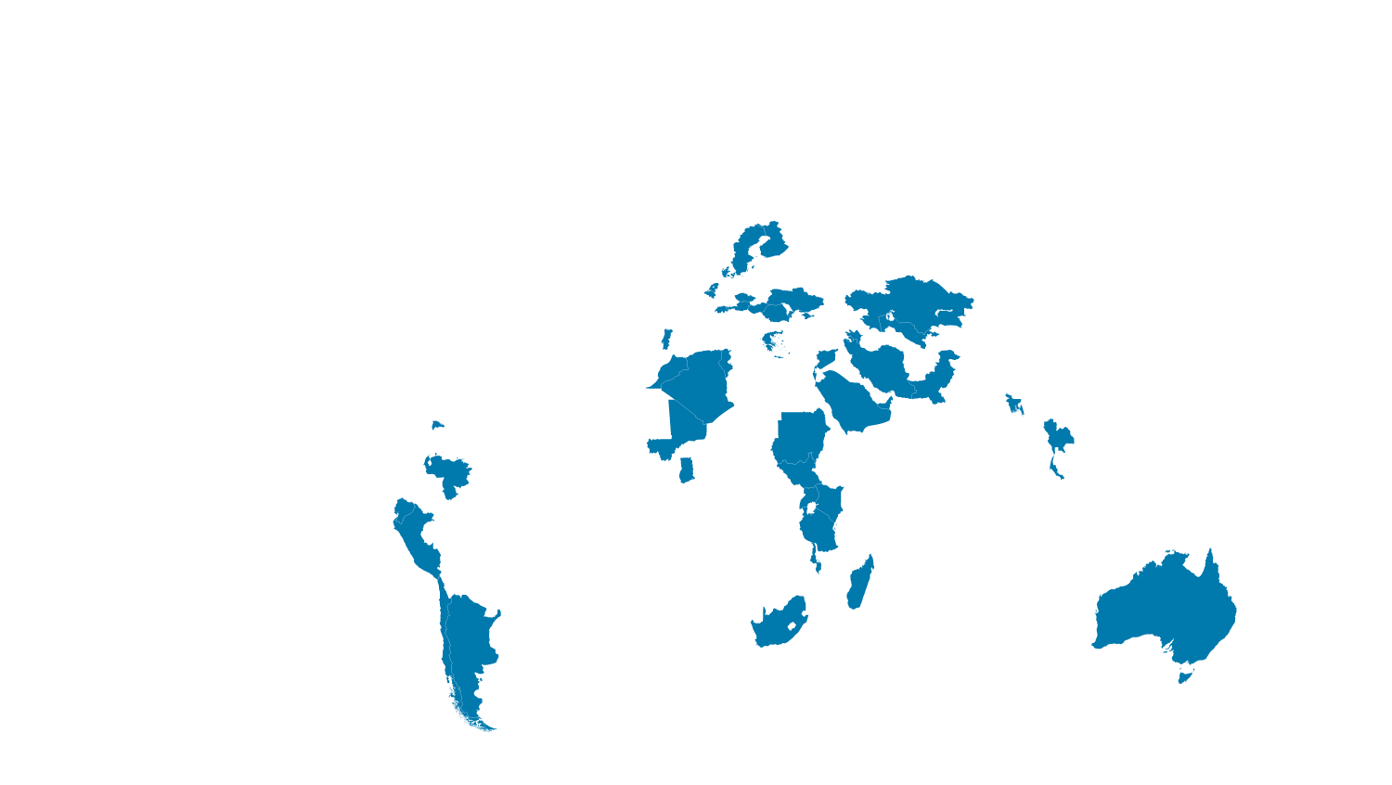
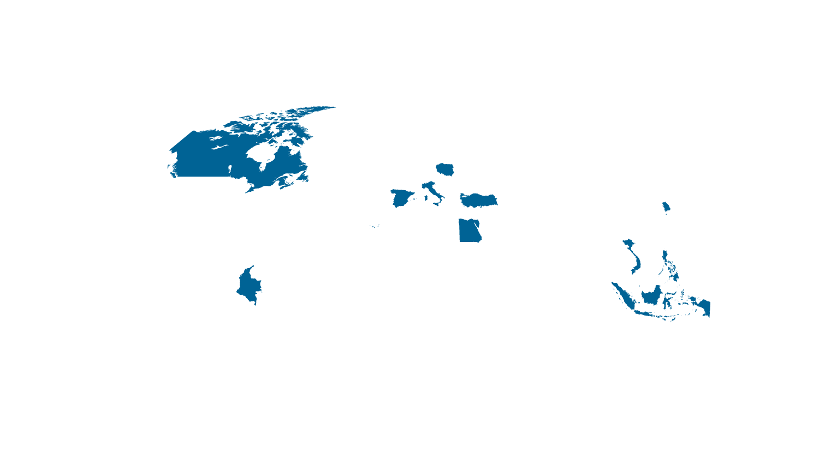
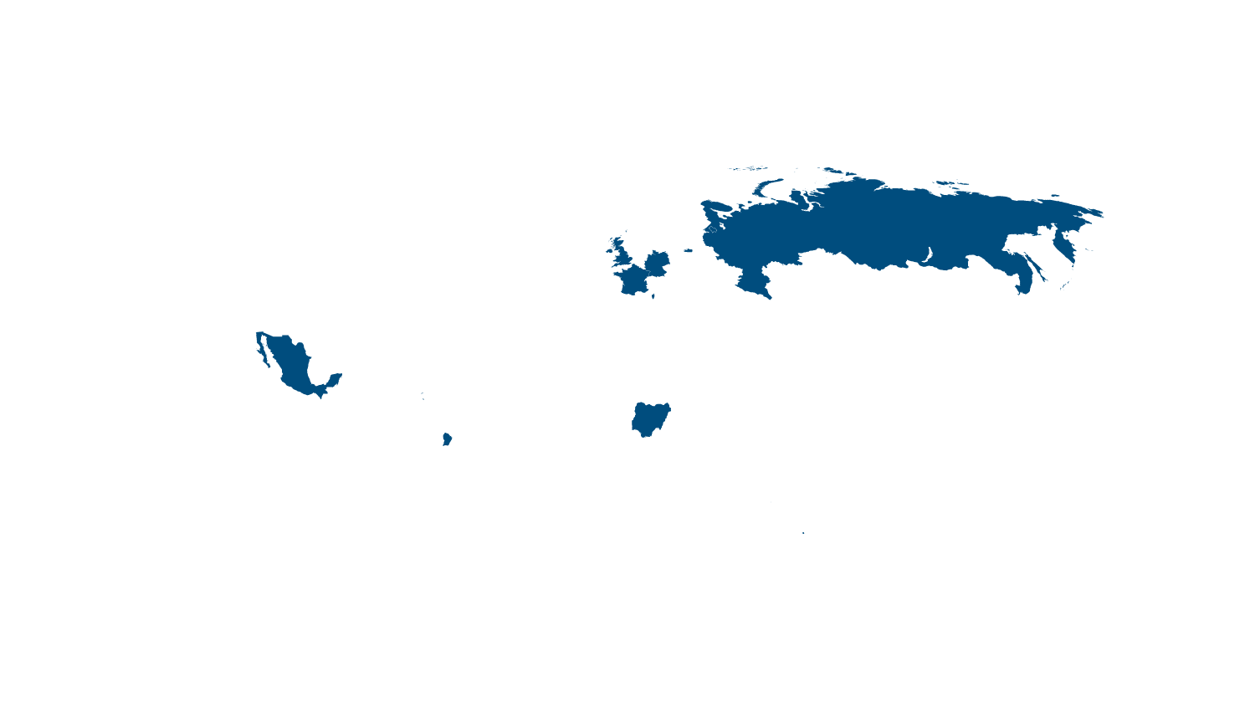


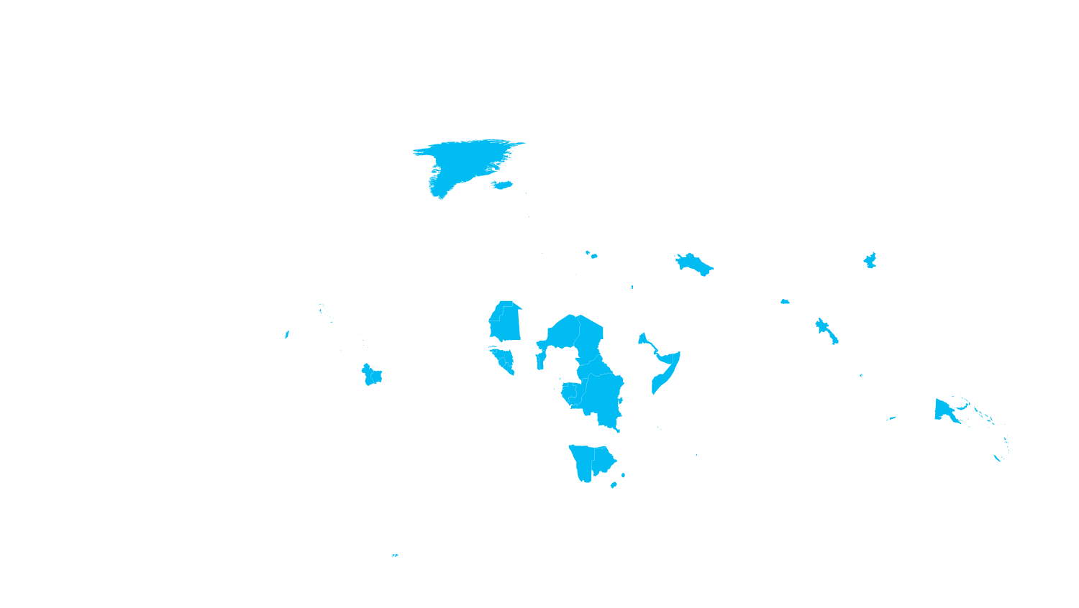




We’ve Built a Worldwide Datacenter Infrastructure
Internet users
■ 500,000,000+
■ 100,000,000 – 499,999,999
■ 50,000,000 – 99,999,999
■ 25,000,000 – 49,999,999
■ 5,000,000 – 24,999,999
■ 100,000 – 4,999,999
■ 50,000 – 999,999
■ 0 – 49,999
*Operated by 21Vianet
Massive Datacenters footprint in over 40 countries
Notes:
Over the last couple of years, we’ve built a huge cloud infrastructure, of datacenters and networks, that has enabled us to grow our cloud services at scale around the globe.
First view: Let’s start by looking at where Internet usage is highest—as this map fills in, you can see high Internet usage in the places we would expect, like the United States and Europe. But also notice the high usage in the countries of India and China.
<click>
Today, Microsoft has a global portfolio of more than 100 datacenters that are located in more than 40 countries worldwide. The locations on this map show the datacenters that are representative of our cloud infrastructure footprint that we talk about publicly. For security reasons, we don’t share the exact location of our datacenters or the exact number that we own and manage.
<click>
This next view shows the 19 Microsoft Azure region’s datacenters that host data for our Azure customers.
These regions each have multiple datacenters within them. This enables Microsoft to offer geo-redundancy within the region to maintain high availability, while helping customers maintain their compliance requirements.
All Microsoft Azure datacenters are paired with another datacenter that's physically separated by hundreds of miles. Data is asynchronously replicated between the two datacenters (when the storage account is enabled for geo-replication) to help protect against an Azure site failure.

Slide 23
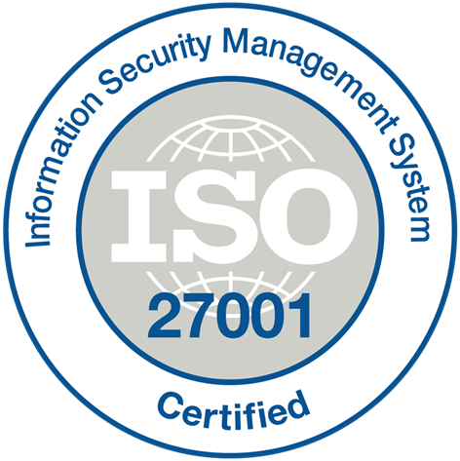



























Azure Compliance The largest compliance portfolio in the industry
ISO 27001
SOC 1 Type 2
SOC 2 Type 2
PCI DSS Level 1
Cloud Controls Matrix
ISO 27018
Content Delivery and Security Association
Shared
Assessments
FedRAMP JAB P-ATO
HIPAA / HITECH
FIPS 140-2
21 CFR
Part 11
FERPA
DISA Level 2
CJIS
IRS 1075
ITAR-ready
Section 508 VPAT
European Union
Model Clauses
EU Safe Harbor
United Kingdom
G-Cloud
China Multi
Layer Protection Scheme
China
GB 18030
China
CCCPPF
Singapore
MTCS Level 3
Australian Signals
Directorate
New
Zealand
GCIO
Japan
Financial Services
ENISA
IAF

Slide 24
Rick suggests taking customers on a Microsoft Data Center Tour
Customers realize that there is a lot more there in terms of high-end computing and security than they could ever do.
He’s seen deals cut in the parking lot after a tour.
Microsoft will help us to set up a tour with customers.

